Slide 1


USED CAR ANALYTICS
Prepared for UMBC Data Science Master's Capstone by
Dr. Chaojie (Jay) Wang
Kaushik Manjunatha
JF96412

Slide 2
BACKGROUND
Total Market Value: $1.6 trillion in the U.S. as of 2023
Market Channels : Dealerships , Private Sales , Online Platforms
Personal Experience with Used Car Pricing
Pricing was overwhelming when searching for a used car.
No reliable method to verify correct pricing.
Relied on word of mouth for pricing validation.
Why does it matter?
This project addresses the common challenge of pricing uncertainty for both buyers and sellers.

Slide 3
RESARCH QUESTIONS
1. Prediction Accuracy
Can machine learning models outperform traditional pricing heuristics in accurately predicting used car values, especially in high-demand vehicle categories like electric, Gasoline and hybrid models?
2. Depreciation Analysis
How does the depreciation rate vary across different car makes and models over time?
Future Scope :
1. Maintenance Cost Prediction
Can we predict the maintenance costs for the used cars?

Slide 4
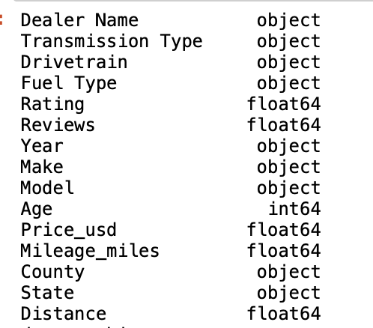
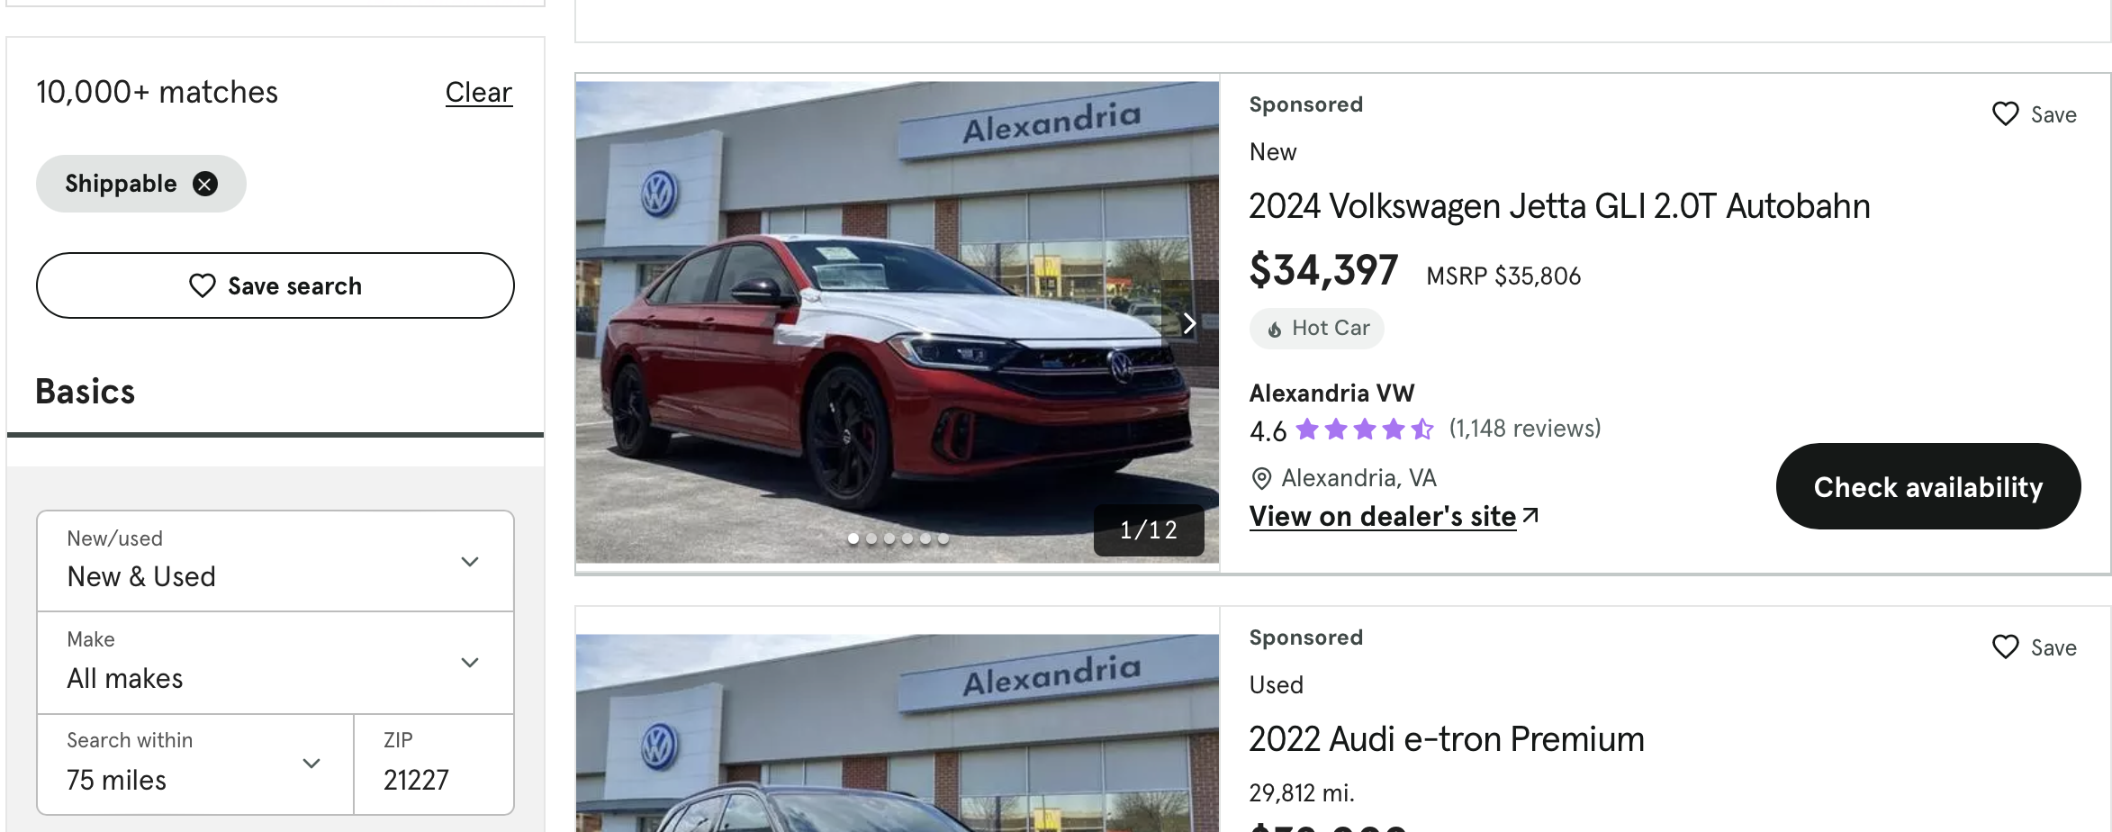
DATA
Data Source is Cars.com (Web scraped). Data Size is 2.9 MB
It has currently 14420 rows and 15 columns.
Target is Price_usd
Each row represents a single car listing from a dealership.
Data scraped from within a 75-mile radius of Baltimore, East Coast US.

Slide 5
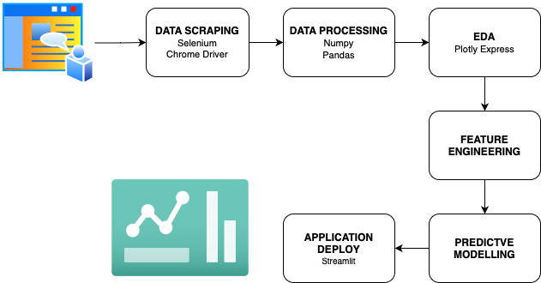
PROJECT IMPLEMENTATION PLAN
Notes:
Appart from price prediction , Im also going to have different dashboards lik top dealership in the area, top seeling. Car, most liked car etc

Slide 6
DATA SCRAPING
Adhering to data extraction policies from http://cars.com/robots.txt
Selenium WebDriver Automates the web browser for scraping.
ChromeDriver Provides the link between Selenium and the Chrome browser for automation.
Pandas is sed for storing scraped data into a DataFrame. Then into CSV.
Scraping Parameters
Transmission Types: E.g., CVT , Manual, Automatic
Drivetrain Types: E.g., Front-Wheel Drive.
Fuel Types: E.g., Gasoline.
Base URL
https://www.cars.com/shopping/results/?transmission_slugs[]=cvt&drivetrain_slugs[]=front_wheel_drive&fuel_slugs[]=gasoline&page=1
Dynamic Pagination based on Fuel type
Throughput – 1 page takes 2 minutes fetching 20 records.

Slide 7
DATA PRE-PROCESSING
Data is collected in multiple files, categorized by region, fuel type, and transmission type. The initial step is merging these into a single dataset.
The "Make," "Model," and "Year" are clustered together in one field, so they are separated into distinct columns.
Car age is calculated based on the current year.
Converted "Price," "Reviews," and "Mileage" to numeric values, handling non-numeric entries.
Extracted "State" and "County" from the "Location" field.
Removed duplicate records, which were identical ads with matching specifications and pricing from the same dealership.

Slide 8
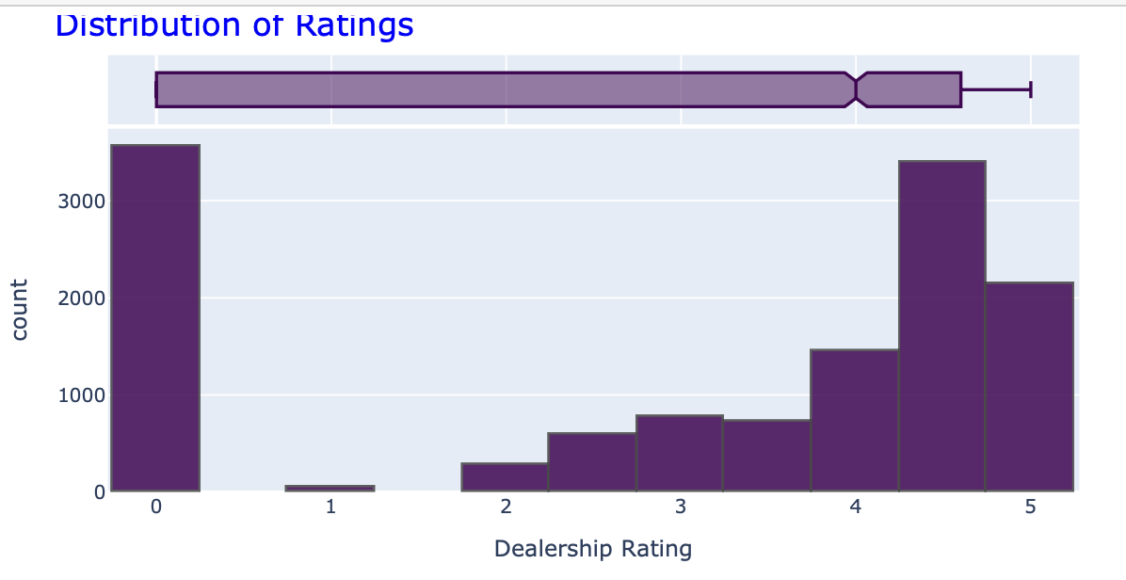
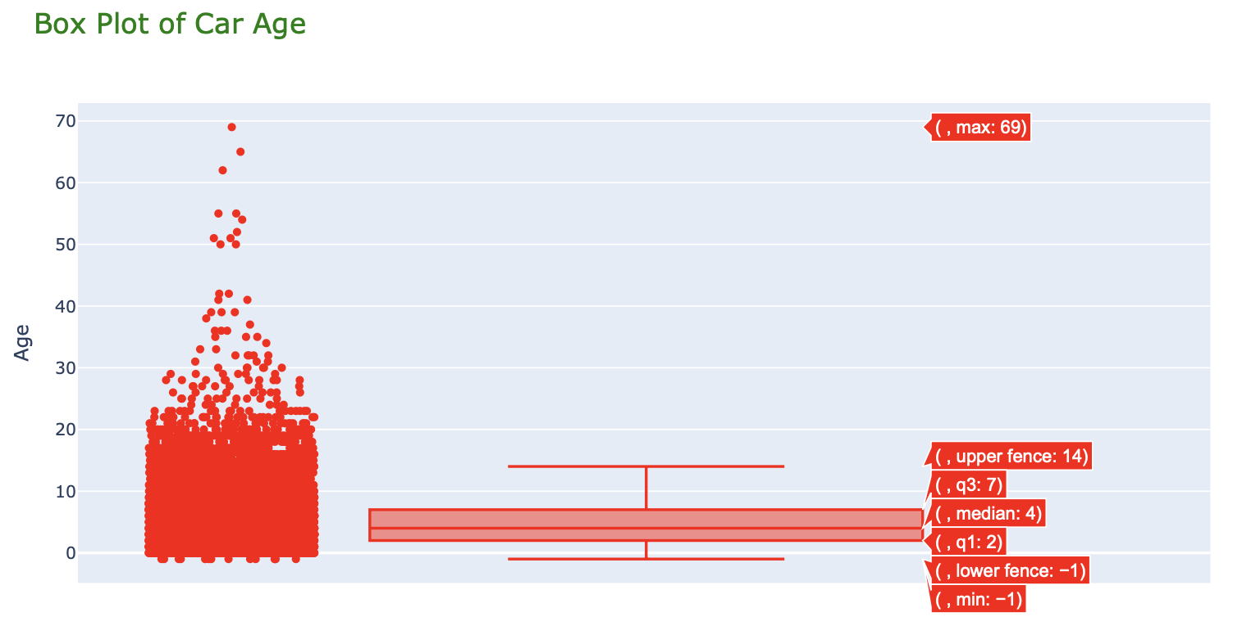
EDA
majority of ratings falling between 4 and 5
poor-rated dealerships represent a small fraction
cars with negative age(-1) are 2025 models
majority of cars are relatively new (median 3 years)
there are some outliers (up to 69 years old) - Vintage cars

Slide 9
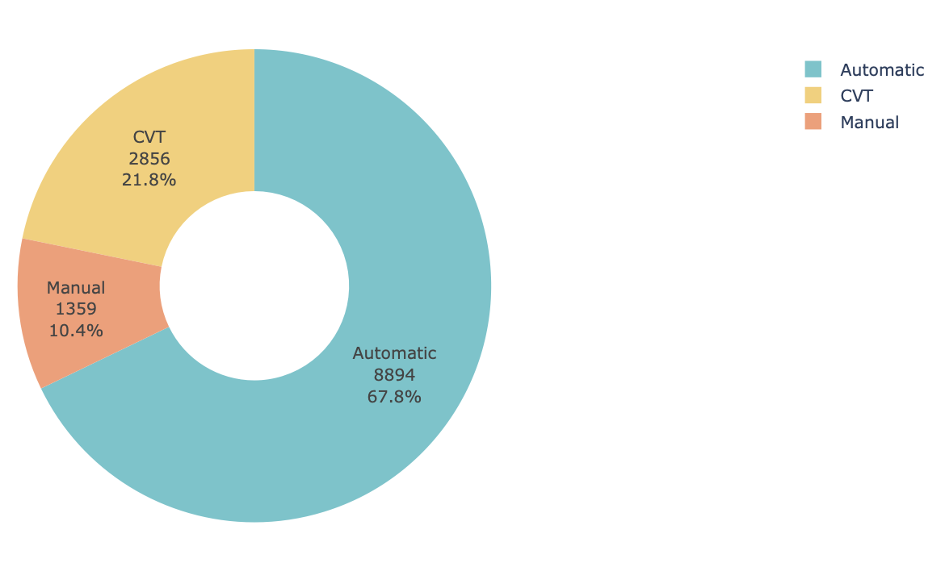
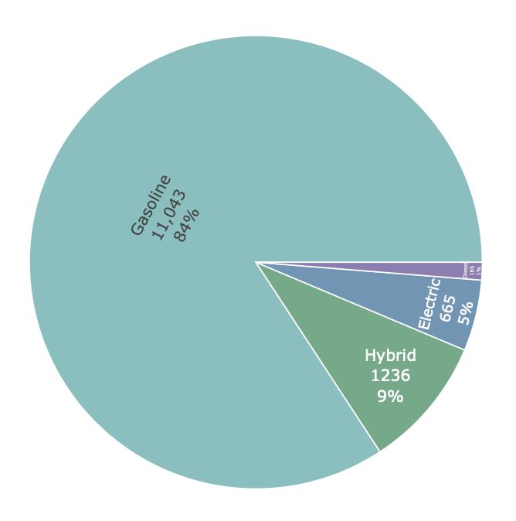
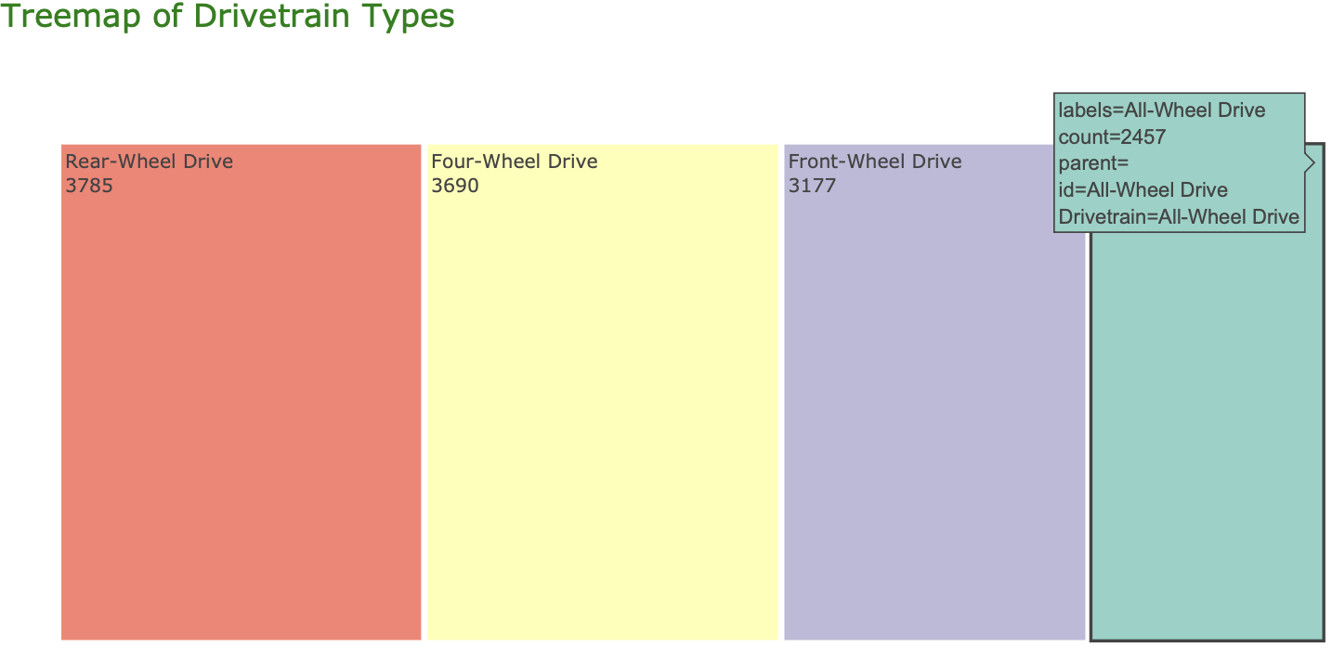
EDA

Slide 10
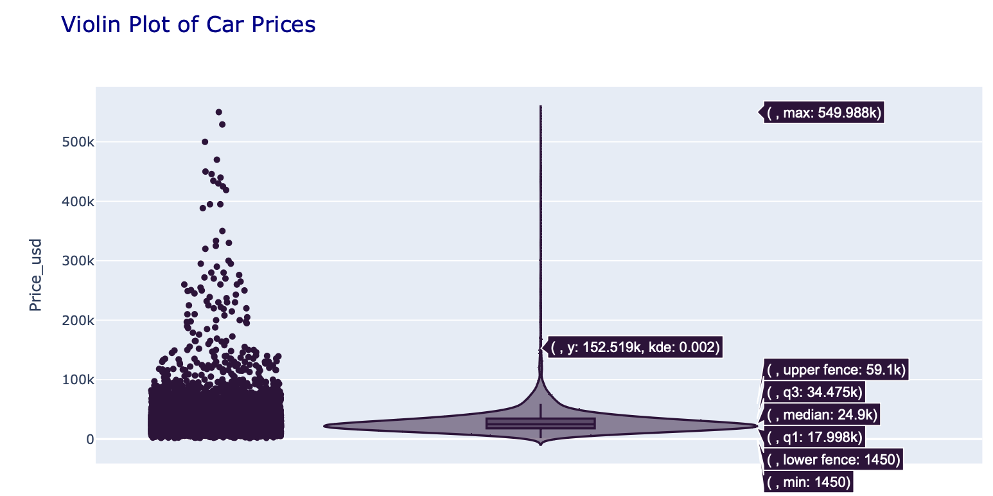
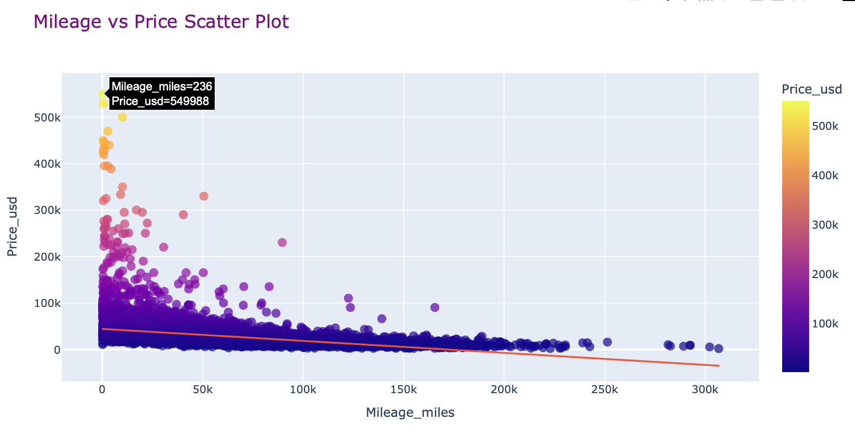
EDA – Price Analysis
majority of car prices are concentrated below $100,000

Slide 11
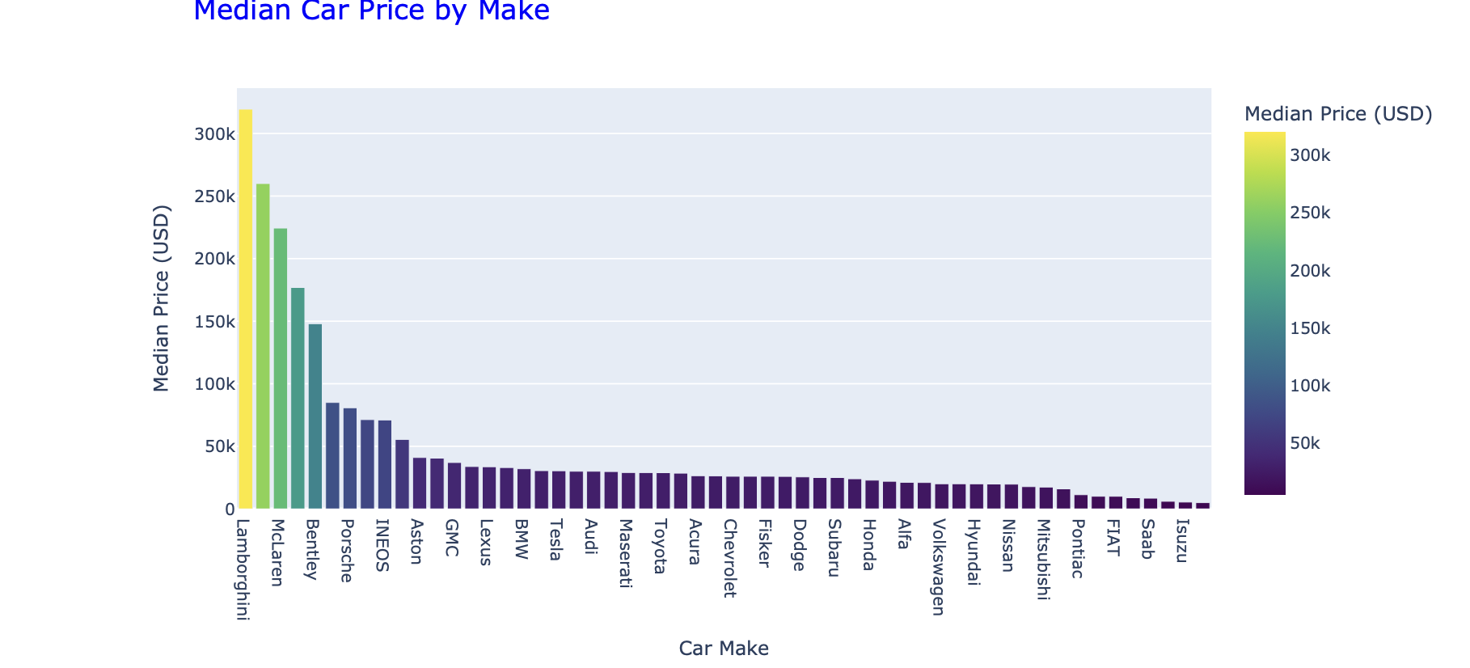
EDA – Price Analysis
Ferrari, Rolls-Royce, and McLaren are still showing the highest median prices.
Other luxury brands like Lamborghini, Jeep, and Lexus also have relatively higher median prices.
common brands such as Ford, Toyota, and Chevrolet have significantly lower median car prices.

Slide 12
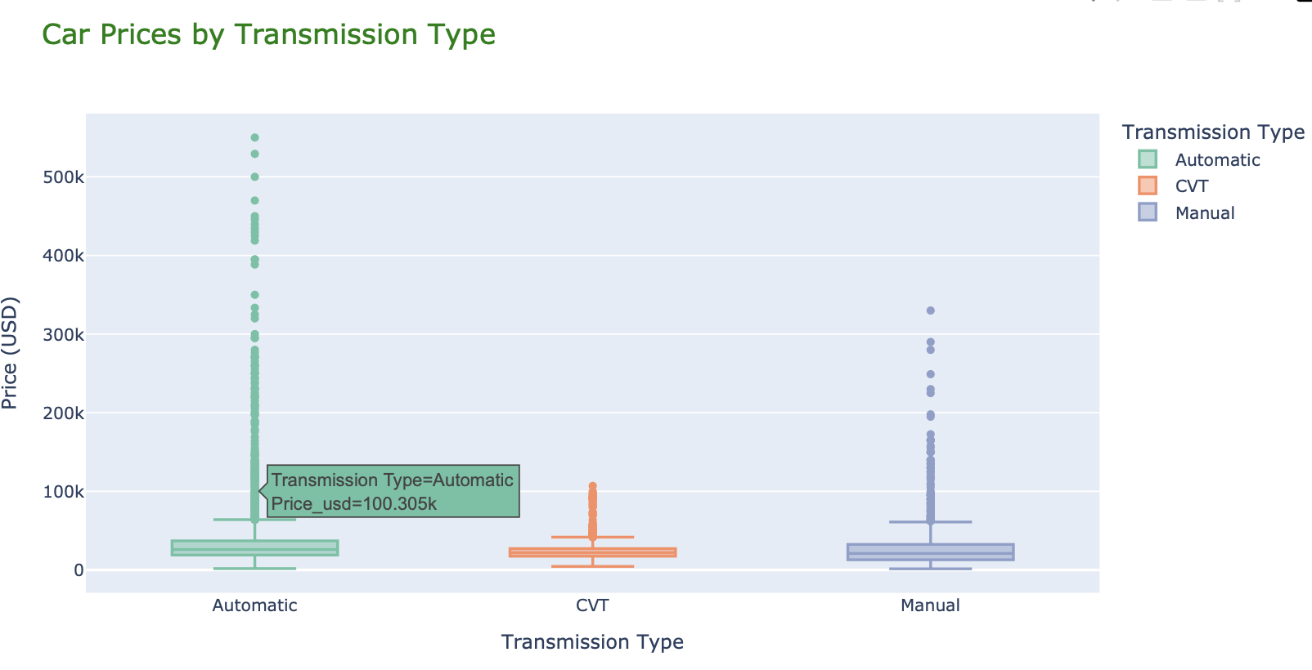
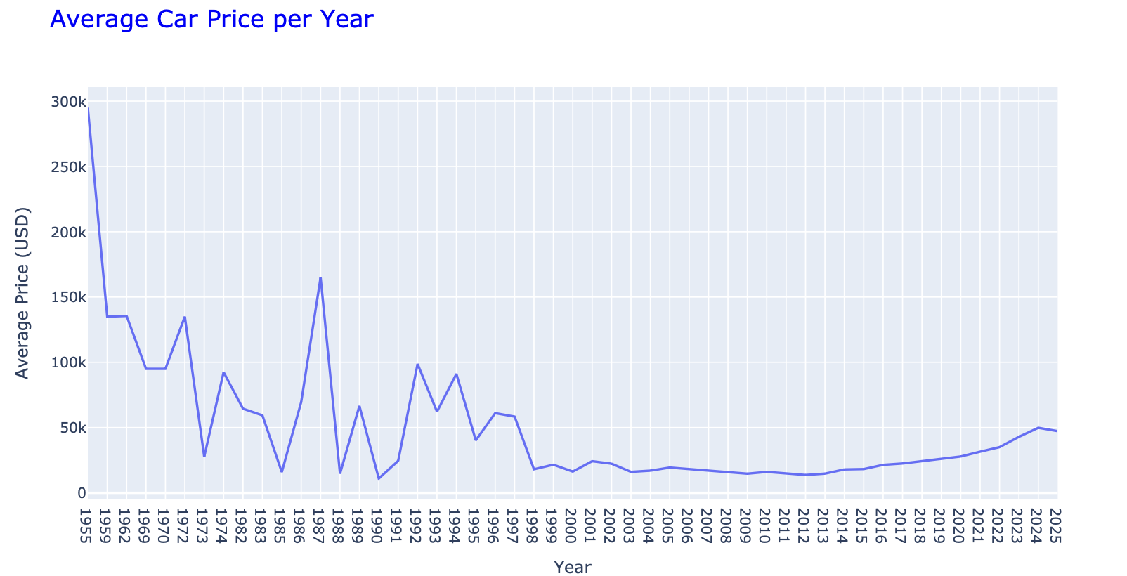
EDA – Price Analysis
Median Price : automatic cars - 100k
CVT - 23k
Manual -25k
Cars from the 1950s to early 1960s have higher average prices, likely because these vehicles are considered rare, collectible, or vintage

Slide 13
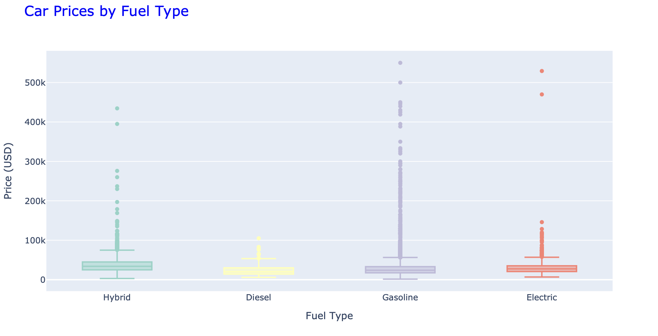
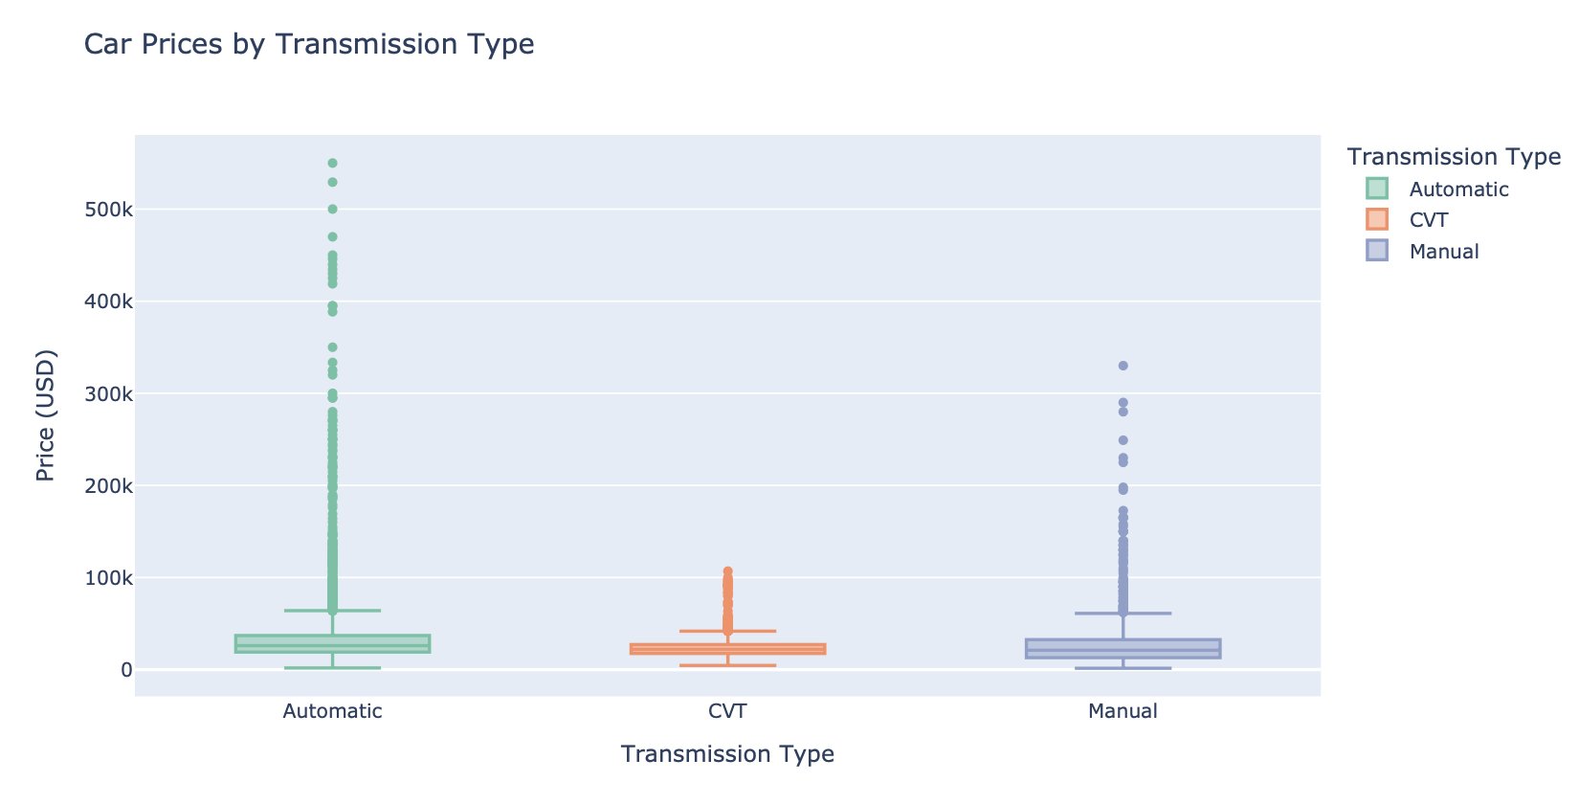
EDA – Price Analysis
Gasoline and hybrid cars exhibit the widest range of prices
Diesel and electric vehicles show more concentrated price distributions
automatic transmissions exhibit the highest price variability
manual and CVT transmissions have more compact price distributions

Slide 14
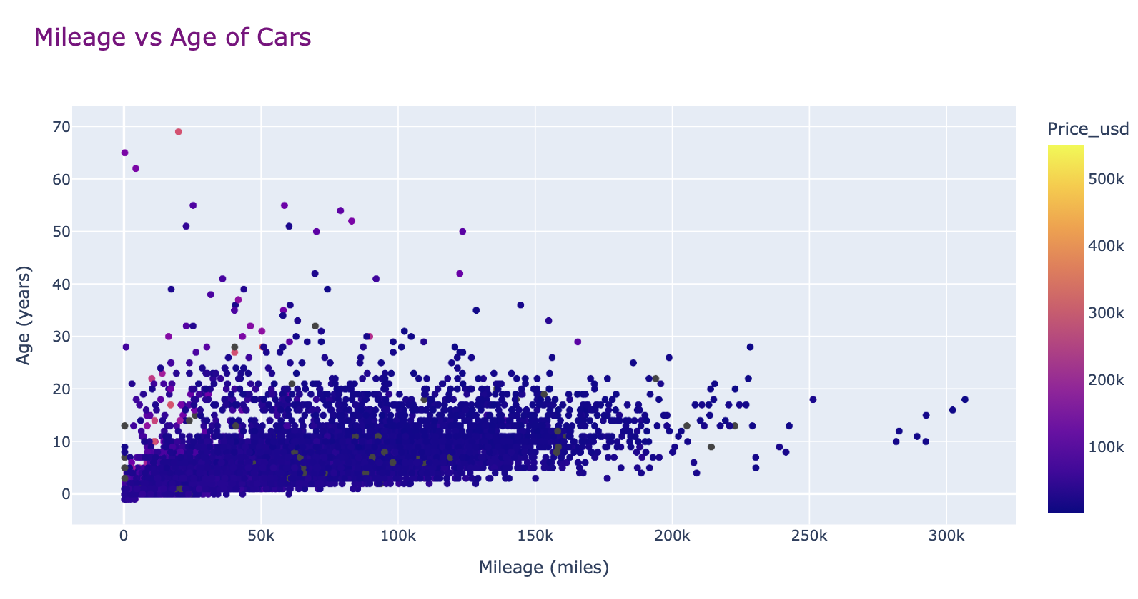
EDA – Price Analysis
cars with ages between 20-40 years have mileage between 100k and 200k miles.
there are a few cars with very high mileage despite being relatively new (ages 0-5 years).
The plot also contains some older vehicles with low mileage, which may represent well-preserved, rare, or collectible cars.

Slide 15
FEATURE ENGINEERING
Impute Missing Values with Mean in that Category(i.e by Transmission type, fuel type, drive train, age )
Categorical Feature Encoding
One Hot Encoding - For Linear Based Models
Label Encoding - For Tree based models

Slide 16
MODEL TRAINING
Initial Attempt
Dataset split : 80 Test – 20 Train
Tree Based Algorithms
Decision Tree - R-squared : 0.6178
Random Forest - R-squared: 0.7904
XGBoost - R-squared: 0.8223
GradientBoost - R-squared: 0.7618
Linear Models
Linear Regression - R-squared: -51310135364.8435
Addressing Linear Models
Multicollinearity in dataset (Age, Year, Dealer)
Non Linear relations (User Reviews and Dealership Rating)
Improvement
Linear Regression - R-squared: - 0.7568

Slide 17
MODEL TRAINING
Ensemble Techniques
Stacking Regressor with Linear Regression Meta Model and tree-based base models.
R-squared: 0.8397
R-squared: 0.8473 (With Hyperparameter tuning for base and meta models)
Stacking Regressor with different meta models
Ridge - R-squared: 0.8726
Lasso - R-squared: 0.8732
Decision Tree - R-squared: 0.7521
Random Forest - R-squared: 0.8570
XGBoost - R-squared: 0.8049
GradientBoost - R-squared: 0.8580
Overfitting problem with Stacking methods
Best Model
XGBoost (n_estimators=100, max_depth=7, learning_rate=0.1)
R-squared: 0.8349

Slide 18
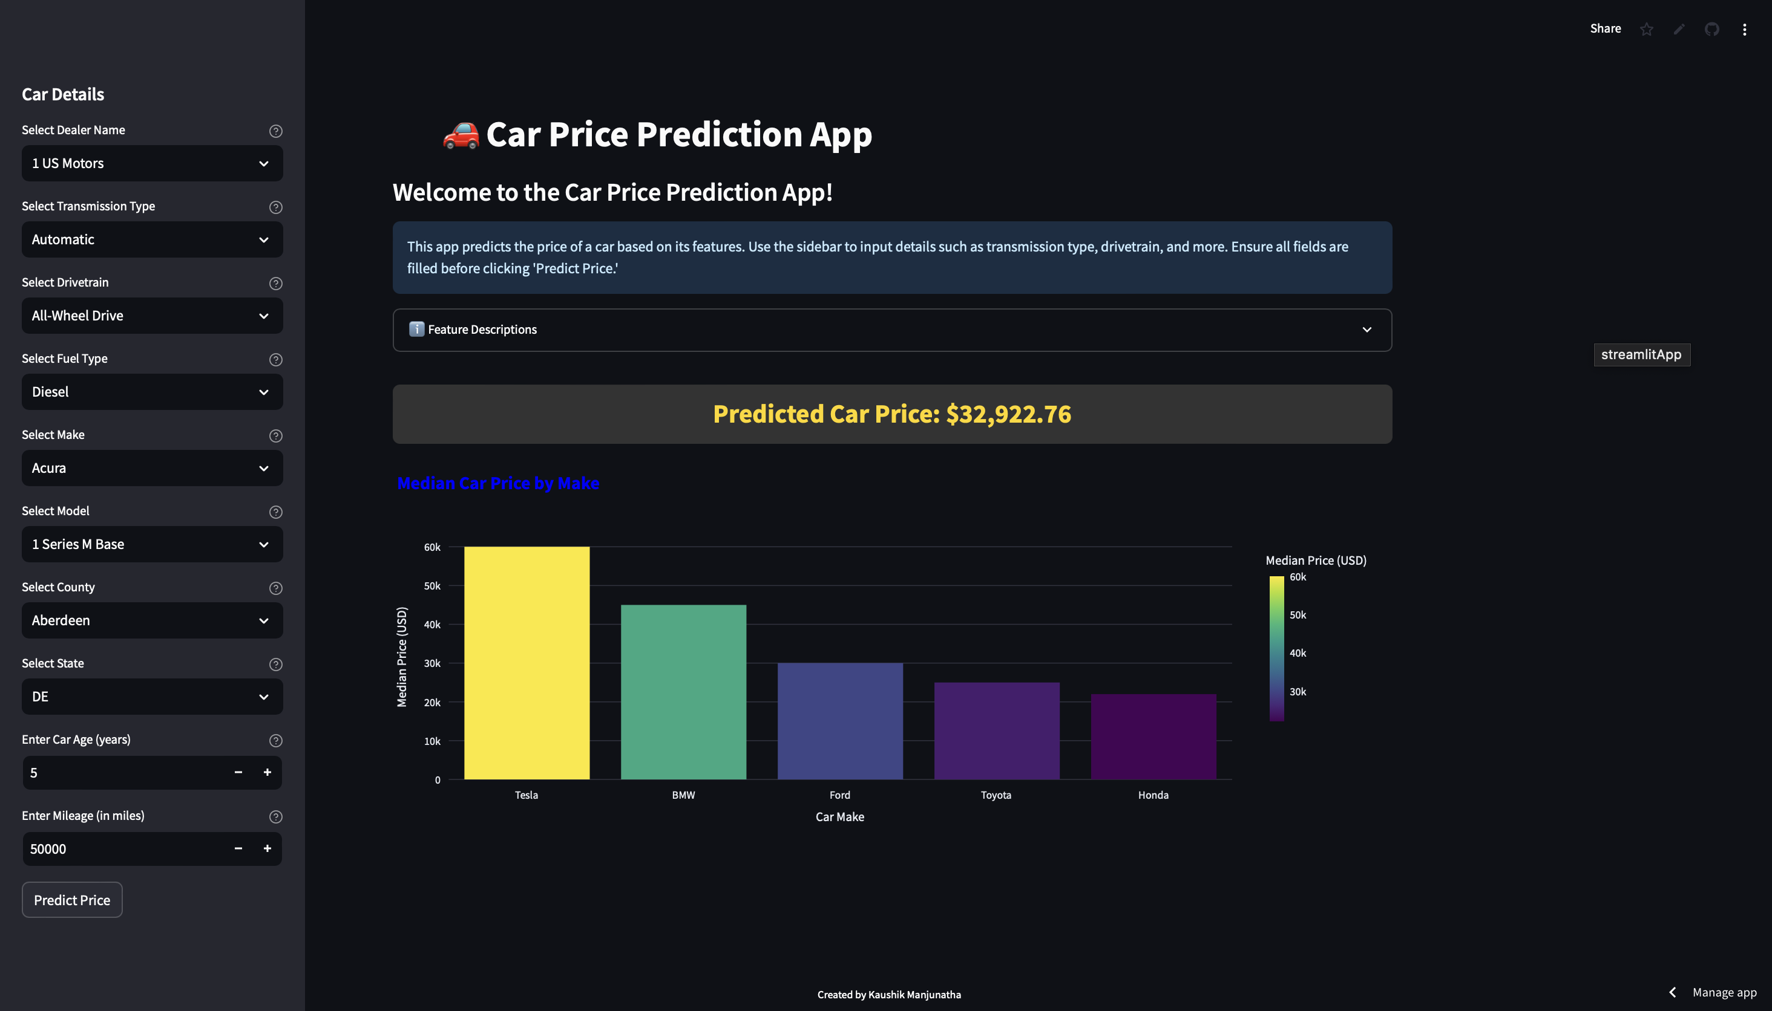
STREAMLIT DEPLOYMENT
Streamlit App
https://used-cars-price-prediction-usa.streamlit.app

Slide 19
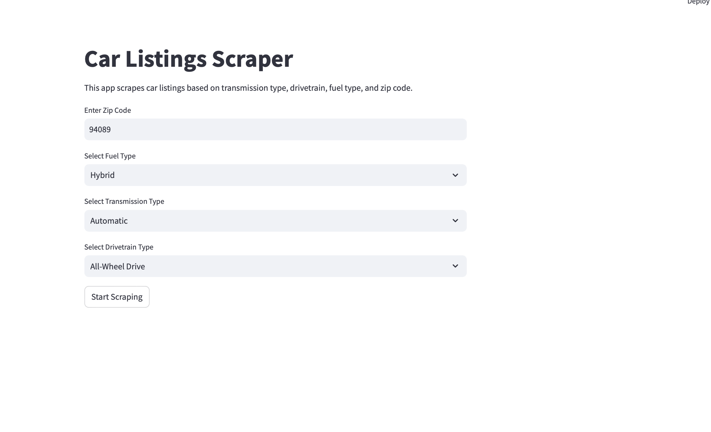
STREAMLIT DEPLOYMENT
Data Scraping

Slide 20
DEMO

Slide 21
CONCLUSION
Mileage, Age , Make, Model are the significant factors affecting the price of the car.
XGBoost with n_estimators=100, max_depth=7 and learning_rate=0.1 is the best performing model with accuracy of 83.24 %.

Slide 22
References
https://brightdata.com/blog/how-tos/using-selenium-for-web-scraping

Slide 23
THANK YOU

